Slide 1
HYDROMER
WWW.HYDROMER.COM

Slide 2
ABOUT US
OFFERS SURFACE COATING TECHNOLOGIES, SHIPPED TO A GLOBAL CUSTOMER BASE, R&D AND CONTRACT COATING SERVICES.
BASED IN CHARLOTTE, NC, USA
SINCE 1980
OUR LEADING-EDGE HYDROPHILIC COATINGS FOR MEDICAL DEVICE AND INDUSTRIAL PRODUCT APPLICATIONS ASSIST OUR CLIENTS TO DIFFERENTIATE FROM THEIR COMPETITION.
FDA, GMP/ISO 13485, ISO 9001 CERTIFIED

Slide 3
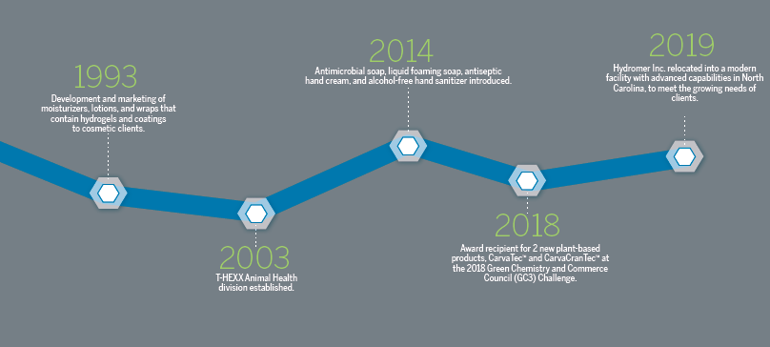
Company History
PIONEER & INDUSTRY LEADER

Slide 4
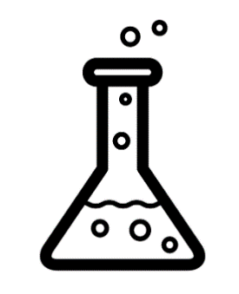
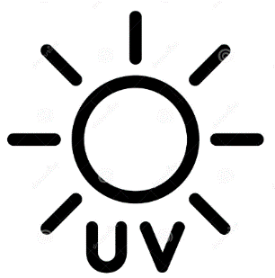
What’s New at Hydromer?
New Leadership Team and Board of Directors
Hydromer welcomes a dynamic new leadership team and board members, poised to drive innovation and growth. With diverse expertise spanning technology, business development, and corporate governance, they are committed to steering Hydromer towards new heights of success in the realm of advanced coatings and biomaterials.
R&D Strategy
Hydromer's innovative R&D strategy centers on augmenting its team with skilled chemists, fostering the creation of advanced coatings tailored for diverse applications across different markets. By leveraging this expertise, we aim to penetrate new markets, revolutionizing industries with cutting-edge solutions that optimize performance and durability.
New UV Curable Coating Line
Hydromer proudly unveils its innovative UV curable coating line, showcasing a commitment to advanced technology and sustainable solutions. Engineered to deliver superior performance and efficiency, this new line underscores our dedication to meeting evolving industry demands while offering customers versatile and environmentally friendly coating options.

Slide 5
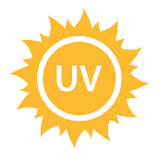
Hydromer’s UV and Thermal Formulations
UV
Cutting-edge technology: Harness the power of our new UV curable coating line.
Tailored to Your Needs: Our coating system can be fine-tuned to seamlessly integrate with your existing processes, ensuring optimal performance and efficiency.
Rapid curing: Achieve perfection in minutes with lightning-fast curing times.
Versatile application: Coat a variety of substrates effortlessly, from plastics to metals and beyond.
Precision curing: Utilize different UV wavelengths for impeccable results every time.
Unrivaled durability: Enjoy long-lasting results with an ultra-durable coating.
Thermal
40+ Years of Proven Expertise: Benefit from over 40 years of proven expertise and market presence.
Superior glide: Encounter unparalleled lubricity with our ultra-slippery thermally cured coating.
FDA-compliant MAF files: Ensure regulatory compliance with FDA-approved Master Access Files (MAF) for peace of mind.
Global recognition: Trusted and approved on medical devices sold around the world, particularly in key markets such as the US, Asia, and Europe.
Versatile Application: Achieve superior hydrophilic coating results with options for both one-step coating and two-step primer systems, ensuring compatibility with diverse substrates and application requirements.

Slide 6
MEDICAL DEVICE COATING SOLUTIONS
Our products are backed by an outstanding R&D, customer service, and tech support capabilities.
Our technologies add value by providing unsurpassed lubricity, thromboresistance, antimicrobial, platelet and protein adhesion reduction, non-leaching, low particulate, bio- compatibility and many other properties.
Our products are sold and used on medical devices around the world and in every system of the body.
A complete suite of custom coatings, coating services, equipment, and turnkey operations for the medical market.

Slide 7
MEDICAL DEVICE COATING SERVICES
Our facility is capable of coating devices ranging from small batches for clinical tests to high volumes suitable for market introduction. This versatility ensures that we can meet your needs at every stage of product development and commercialization.
Once coated, devices can be delivered in bulk or assembled, packaged and sterilized with client labeling at our facility.
Hydromer also offers contract R&D, custom machine building and tech transfer services.

Slide 8
MEDICAL DEVICES WE COAT
Angioplasty balloon catheters
Umbilical catheters
Biliary and pancreatic stents
Infusion microcatheters
Cardiovascular micro catheters
Central venous catheters
Intraocular lens injectors
Embolization delivery devices
Liposuction devices
Enteral feeding products
Neurovascular microcatheters
Female contraceptive devices
PTCA catheters
Foley catheters, urinary catheters
Guide wires
Hemodialysis catheters
Interocular lens devices
And many more

Slide 9
INDUSTRIAL PRODUCTS
For industrial applications, Hydromer offers anti-fog, anti-frost and condensation control products. These coating products are optically clear with excellent heat and UV stability and available in solvent or water-based systems.
Our products can be easily applied through various methods such as dip, spin, spray or flow coating and are then cured by heat.
Our product line can be used on a wide variety of substrates such as PC, acrylics, PU, PVC, Glass, Teflon, Aluminum and others.

Slide 10
INDUSTRIAL PRODUCTS
COATING APPLICATIONS
Automotive
Aviation and Aerospace
Personal and Safety eye protection
Military Optics
Commercial freezers
Civil and military aviation oxygen visors for anti-fog
protection and more
Boating

Slide 11
THANK YOU!

